Slide 1
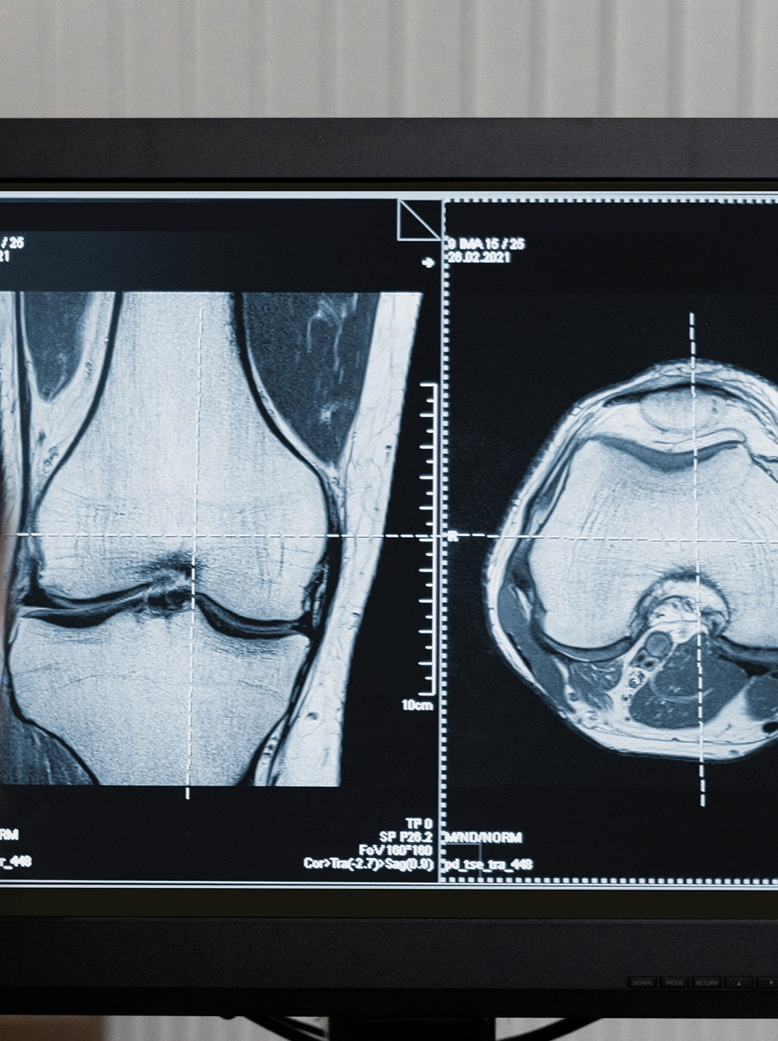
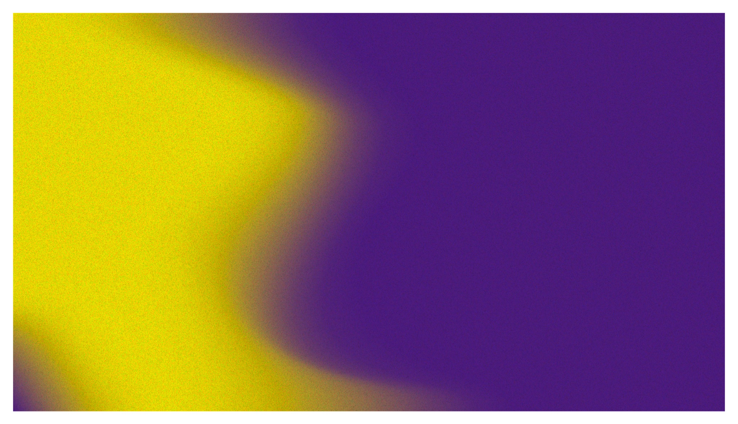
IMAGE SEGMENTATION OF SPLEEN
Prof. GEETHA.S
Machine Intelligence for Medical Image Analysis – CSE3042
JANICE ZIONA ABRAHAM 20BAI1312

Slide 2
TITLE: IMAGE SEGMENTATION OF SPLEEN

Slide 3
TABLE OF CONTENTS
01
02
ABSTRACT & MOTIVATION
EXISTING TECHNIQUES
03
04
LITERATURE REVIEW
PROPOSED ARCHITECTURE

Slide 4
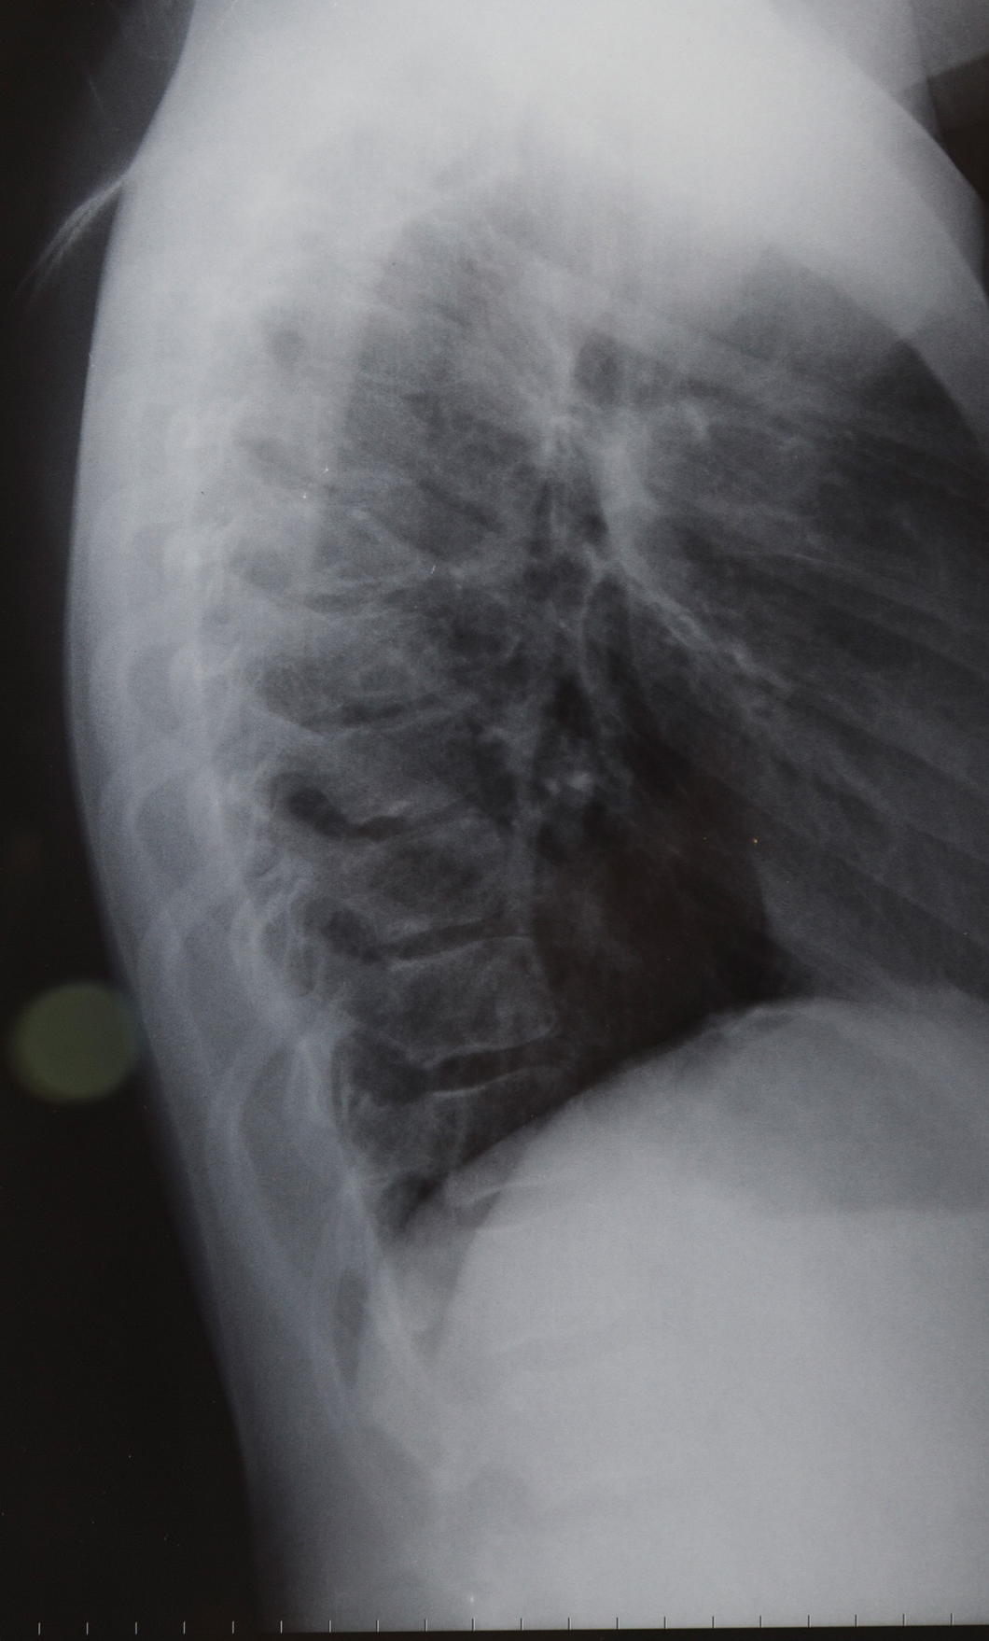
ABSTRACT
A key step in medical image analysis is picture segmentation, which makes it easier to identify and delineate particular anatomical structures. In our study, we aim to illustrate how the UNet architecture can segment the spleen effectively. The spleen borders are precisely delineated by the model, which takes advantage of its innate capacity to recognize complex spatial relationships within the images. Since this method can conduct both 2D and 3D segmentation, we assume that it is effective.

Slide 5
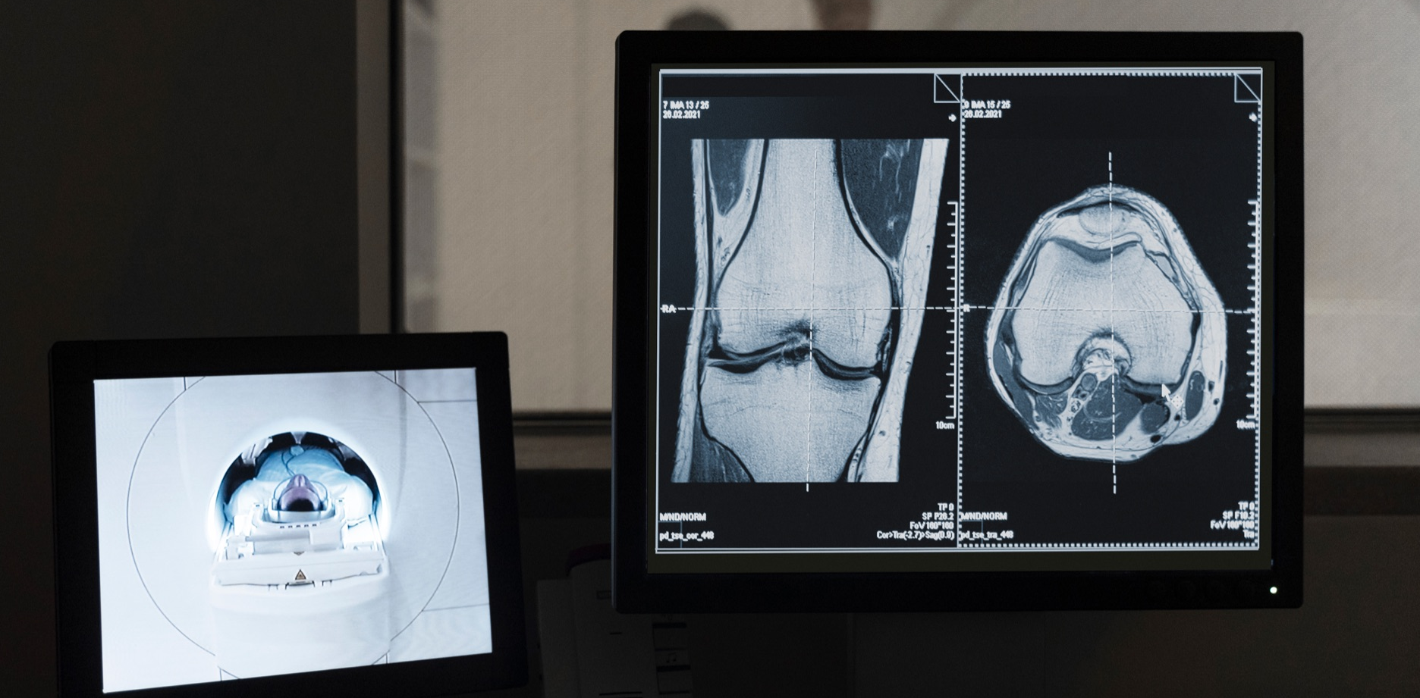
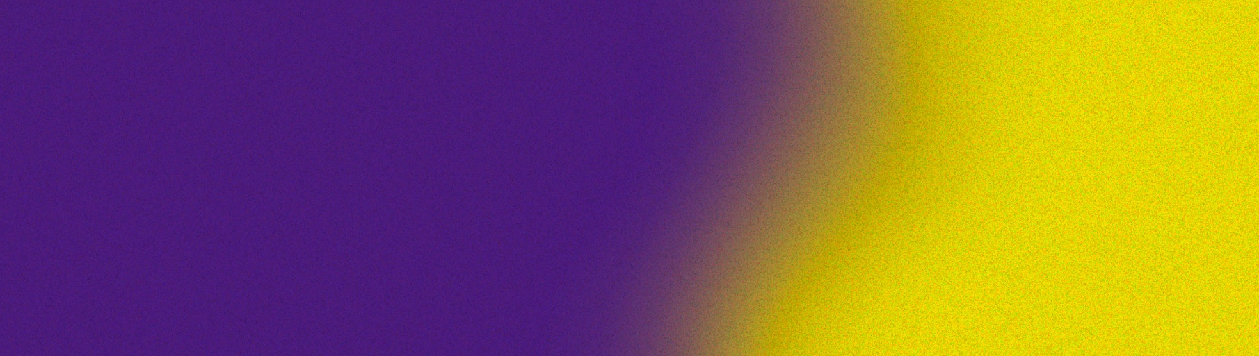
MOTIVATION
Researching image segmentation of the spleen in the context of medical image analysis is motivated by the need to improve patient care, assist medical professionals in diagnosis and treatment planning, advance medical research, and leverage technological advancements in AI and machine learning to address the challenges associated with spleen segmentation. This research has the potential to enhance the accuracy, efficiency, and effectiveness of healthcare practices related to the spleen and abdominal health.

Slide 6
DATASET USED
Medical Decathalon dataset has been used which contains multiple datasets containing the images of the various CT images of various internal body parts. I have chosen the spleen dataset for this project
Link to the drive: https://drive.google.com/drive/folders/1HqEgzS8BV2c7xYNrZdEAnrHk7osJJ--2

Slide 7
EXISTING TECHNIQUES
Listed below are some existing techniques that are used in Image Segmentation of Spleen.
The choice of technique depends on factors like the nature of the medical images, available computational resources, the need for real-time segmentation, and the availability of labeled data.
Thresholding and Region Growing | Simple and computationally efficient.
Active Contour Models (Snakes) | Can handle irregular spleen shapes.
Graph Cut Segmentation | Can capture spatial relationships well.
Level Set Methods | Versatile and can handle topological changes.

Slide 8
EXISTING TECHNIQUES
Deep learning methods, especially CNNs and U-Net variants, have gained prominence due to their ability to handle complex spleen shapes and varying image characteristics, but they also require substantial data and computing power for training.
Machine Learning Techniques | Can be effective with carefully selected features.
Convolutional Neural Networks (CNNs) | High accuracy, can handle complex spleen shapes and varying intensities, and can learn hierarchical representations.
U-Net and Variants | Excellent performance, widely used in medical image segmentation tasks.
3D Segmentation Techniques | Captures spatial context in 3D images.

Slide 9
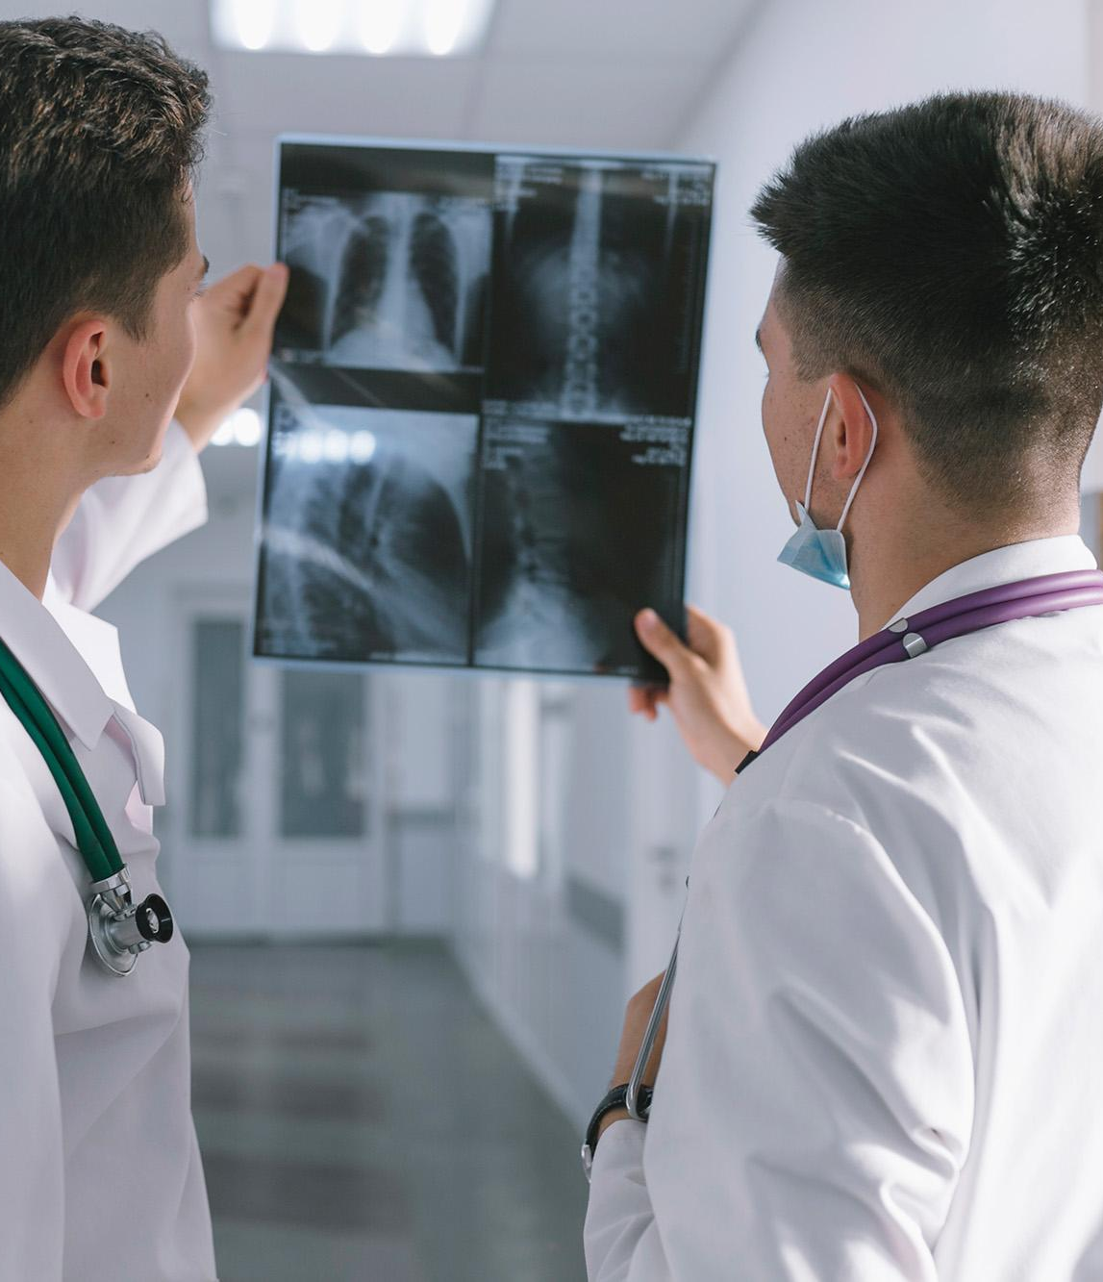
Paper 1 – Multi-organ Segmentation over Partially Labeled Datasets with Multi-scale Feature Abstraction
The spleen dataset is used to train a Deep Neural Network (DNN) model for an objective segmentation procedure. The model is improved and tuned using convolution. The use of partially annotated datasets in this model is a novel aspect of the paper. We may deduce that they are partially labelled and classify the dataset as "semi supervised," which refers to a combination of supervised and unsupervised data. The fact that they used multiple medical imaging datasets for training rather than just different datasets of the same part, such as eg LiTS as an alternate training dataset to spleen, is another noteworthy aspect.

Slide 10
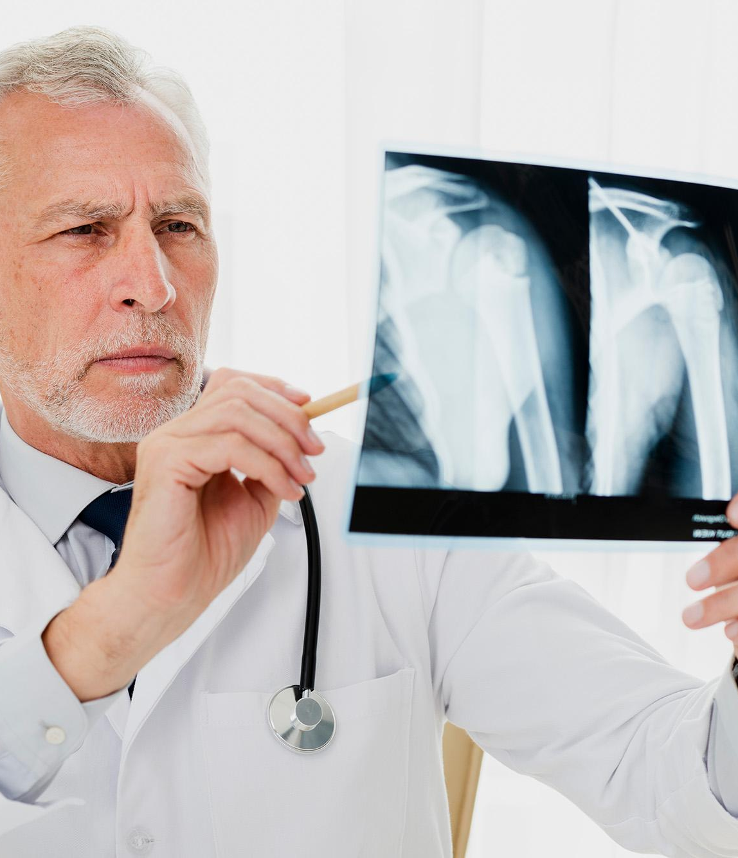
Paper 2 - White Pulp Segmentation Algorithm for Mouse Spleen Cryo-imaging Data Using U-Net
Although the dataset that has been used is that of mouse spleen, they have implemented the U-Net method for image segmentation. The experiment has achieved 87% accuracy and results matched with that of the previous reports that involved a manual procedure. This algorithm involves pre processing, prediction and post processing of the dataset and the images are processed in RGB format. For prediction, instead of a train test split, the model uses two groups called trained and untrained (untrained being the test set). Evaluation of these predictions were done using a 3D surface renderer.

Slide 11
Paper 3 - Robust Multi-contrast MRI Spleen Segmentation for Splenomegaly using Multi-atlas Segmentation
This study recommends employing an automated procedure called multi atlas segmentation, which takes into account outliers and separates the MRI scan of the spleen picture. A graph is created using this data to show the segmentation process' outcomes. When compared to a manual picture segmentation process, the SIMPLE and L-SIMPLE techniques received a Pearson correlation score of 0.97. Four automatic pipelines cherry-pick the atlas parts needed for the splices as part of the pre-processing. The graph is used for post-processing to refine and improve accuracy.

Slide 12
Paper 4 - SynSeg-Net: Synthetic Segmentation Without Target Modality Ground Truth
The SynSeg-Net approach, a convolutional neural network that does not require labels, was used by the authors of this paper. This would imply that the model can be trained using an unsupervised collection of image data. Splenomegaly segmentation for abdominal images and synthetic segmentation on brain images were used as the subjects of the experiment. The second scenario can be viewed as a hyper parameter tuning technique for the underlying model. A similar response to a ResNet Model's was given to the model. In contrast to manual models that only use 2D segmentation, this model also supports 3D segmentation. The fact that this model is divided into two phases ensures more precision.

Slide 13
Paper 5- Deep Profiling of Mouse Splenic Architecture with CODEX Multiplexed Imaging
In order to comprehend complex cell compositions, this study used a multiplexed imaging approach called CODEX (CO-Detection by indexing). They hope to learn more about the spleen's anatomy and its role in immunity using this method. The study then compares infection responses between a live and a dead cell in an experiment to highlight differences as part of image categorization. Because it would aid in comprehending identical tissue features and capabilities, this approach has been selected.

Slide 14
Paper 6 –Detection of Splenomegaly in Poultry Carcasses by UV and Visible Light Imaging
In this study, the authors employ a computer vision system to identify splenomegaly, a disease indicator, in turkey carcasses. When exposed to fluorescent and UV lights, the images are colored. The image-processing system aids in differentiating the spleen from other organs, and the classification rates for self- and independent testing in spleen detection are 92% and 95%, respectively. Higher spleen weight samples also show a strong association. The medical image's spleen's color could be distinguished thanks to the application of UV lighting, which also facilitated extraction.

Slide 15
Paper 7 - TransNorm: Transformer Provides a Strong Spatial Normalization Mechanism for a Deep Segmentation Model
In order to capture both local and global contexts, this work seeks to develop a new medical picture segmentation model called TransNorm that makes use of CNN and Transformers. The multi scale local features are fed into a CNN encoder, which uses a Transformer module to understand long-range dependencies. This model's Dice score of 0.9173 demonstrates that it outperforms other models in terms of efficacy when compared to CT images.

Slide 16
Paper 8 - Atlas-Based Automated Segmentation of Spleen and Liver Using Adaptive Enhancement Estimation
In the paper, an atlas segmentation method is used to show a fully automated method for segmenting the spleen from CT scans. When labeling the necessary tissue for extraction, it first performs adaptive enhancement using a probabilistic atlas created from manually segmented pictures. The Dice coefficient for this approach, which has been tested over 34 CT scans, is 95.2%. Additionally, it was shown to segment across both a normal and an enlarged spleen. The accuracy and functionality of the model have also been enhanced by the application of morphological methodologies by the authors.

Slide 17
Paper 9 - UNETR: Transformers for 3D Medical Image Segmentation
This study employs a novel model known as UNETR that makes use of both CNNs and Transformers. Compared to the pixels from the spleen that contribute to the image, the achieved Dice Score of 95% accurately represents the borders. This method places a strong emphasis on automating the algorithm's efficiency in 3D segmentation and offers a better benefit over 2D segmentation in light of the fact that the latter cannot capture long-range dependencies due to the proximity between convolutional layers.

Slide 18
Paper 10 - DR-Net: dual-rotation network with feature map enhancement for medical image segmentation
This paper proposes a dual residual network (DR-Net) for segmenting several organs from three separate datasets—the spleen, abdomen, and kidneys. Rotation into features and rotation into multiscale features are its two branches. The multi-feature branch focuses on many features through compression and expansion on various scales. In contrast, the feature branch concentrates on a single part by dynamically rotating feature maps at various intervals and aiding with spleen segmentation. The program successfully segmented the spleen by capturing its boundaries and morphology, yielding findings of 87.34%.

Slide 19
Paper 11 - Fully Automated Spleen Localization and Segmentation Using Machine Learning and 3D Active Contours
In the paper, an automated method for locating and segmenting the spleen in abdominal CT scans is. Manual segmentation, is subjective and time-consuming. Using trained classifiers, intensity/position data, and a single axial slice, the approach first localizes the spleen. Based on the intensities of the localized region, it applies an adaptive mask to emphasize the pixels of the spleen. For 3D active contour segmentation that is started from the localized region, the 2D slices are combined into a 3D volume. This model's spleen segmentation Dice score was 0.873, but several examples were rejected by the model due to a deficiency in annotations.

Slide 20
Paper 12 - INet: Convolutional Networks for Biomedical Image Segmentation
This study compares various deep learning models (INet, ResUNet, etc.) for segmenting biological pictures across various datasets, including CT scans of the spleen. They employ a spleen CT dataset made up of 40 contrast-enhanced CT images since precise spleen segmentation is crucial for analyzing variables that affect spleen size. With a 92% Dice similarity coefficient for spleen segmentation, INet outperformed the competition, followed by ResUNet.

Slide 21
Paper 13 - Organ Segmentation from 3D Abdominal CT Images Based on Atlas Selection and Graph Cut
Segmentation from 3D abdominal CT scans is carried out utilizing numerous datasets, including the liver, spleen, pancreas, and kidneys, using atlas-based segmentation and graph cuts. These atlases are created by grouping a database of annotated CT volumes according to how closely the images resemble one another. The atlas that best matches the new input image is chosen. The model's accuracy was roughly 90%, but as more atlases were used in the database to eliminate false positives, accuracy increased. After that, it and graph cuts are used for refinement.

Slide 22
Paper 14 - Longitudinal micro-CT evaluation of liver and spleen tumors in mice using an iodinated blood-pool contrast agent
In the investigation described in this paper, mice with liver or spleen tumors performed micro-CT scans before and up to 15 days after receiving an intravenous injection of DHOG. The study evaluated an iodinated blood-pool contrast agent. Analysis was done on contrast enhancement over time. For up to 15 days, the DHOG allowed for clear vision of liver and spleen tumors, with peak enhancement occurring at 30 minutes and progressively fading over time. One method of measuring tumor size is longitudinally. This method was not fully useful, but it helped us understand how spleen structures differed because small metastases were hard to spot and extra-capsular spleen tumors couldn't be quantified precisely.

Slide 23
Paper 15 - Deep Learning for Automatic Spleen Length Measurement in Sickle Cell Disease Patients
In this study, spleen length from ultrasound pictures was automatically measured using a deep learning method. Splenomegaly, which is a common symptom of sickle cell disease, requires precise measurement for monitoring. The authors create and contrast two deep learning models: a direct regression method using a VGG-19 network and a segmentation-based approach using U-Net. 72 ultrasound pictures are used to train the models. In comparison to other approaches, the segmentation model had a Pearson's linear error of 1.26 cm as opposed to 1.38-1.67 cm for physicians, which is close to inter-observer variability. Direct regression had inferior results.

Slide 24
PROPOSED ARCHITECTURE
The U-Net architecture is a convolutional neural network (CNN) that is commonly used for semantic segmentation tasks in image processing. U-Net has become a widely used architecture in biomedical image segmentation and in various computer vision applications. The architecture is known for its ability to generate accurate segmentation masks while minimizing the loss of spatial information.

Slide 25
Encoder
The encoder is responsible for capturing the context and features of the input image. It's a series of convolutional and pooling layers that gradually reduce the spatial dimensions of the input image.
Each convolutional layer is typically followed by a rectified linear unit (ReLU) activation function, which introduces non-linearity into the model.
After each convolution operation, max pooling is performed to down sample the feature maps.
The number of feature maps (or channels) typically increases with depth in the encoder, allowing the network to capture features that are more complex.

Slide 26
Bottleneck
The bottleneck is a critical component of the U-Net architecture. It's a set of convolutional layers that connect the encoder and the decoder. These layers capture high-level features and create a bottleneck structure.
They act as a bridge between the low-level spatial information and high-level semantic information.

Slide 27
Decoder
The decoder's job is to up sample the feature maps to generate a segmentation map that matches the input image's original dimensions.
It consists of a series of transposed convolution (also known as deconvolution or up sampling) layers, which increase the spatial resolution.
Skip connections are a crucial feature of the U-Net architecture. These connections skip over the bottleneck and directly connect the corresponding layers in the encoder to the decoder. These connections help in preserving fine-grained spatial information.
Each decoder layer typically combines feature maps from the corresponding encoder layer and the up sampled feature maps, often using concatenation or addition.
After the concatenation of feature maps from the encoder and decoder, additional convolutional layers are applied, followed by ReLU activation.

Slide 28
Output Layer
The final layer of the decoder typically consists of a 1x1 convolution followed by a suitable activation function (e.g., sigmoid or soft max) depending on the task (binary or multi-class segmentation).

Slide 29
INET ARCHITECTURE
INet is a convolutional neural network designed for biomedical image segmentation tasks. Unlike methods that expand receptive fields through downsampling, INet keeps feature map sizes fixed while gradually increasing kernel sizes. This helps maintain important spatial information. INet also fuses multi-scale features by concatenating outputs from all preceding convolutional layers. Experiments show INet achieves state-of-the-art segmentation accuracy for applications like spleen segmentation from CT scans.

Slide 30
INET ARCHITECTURE
-Overview of key components
Fixed-sized feature maps to maintain spatial resolution
Gradually increased kernel sizes from 3x3 to 7x7 to 15x15 to expand receptive fields
Concatenation of feature maps across layers to fuse multi-scale information

Slide 31
INET ARCHITECTURE
-Detailed layer structure
Input image
3x3 convolutional subnetwork
7x7 convolutional subnetwork
15x15 convolutional subnetwork
Concatenation of outputs

Slide 32
INET ARCHITECTURE
-Training Enhancements:
Residual connections accelerate gradient flow.
Overlapping max poolings with stride 1 extract sharpest features.
Convolutional indices guide network to learn multi-scale representation.
Therefore, INet enables accurate segmentation while preserving important spatial information
Has potential for wide medical applications in diagnosis, treatment planning

Slide 33
THANK YOU!

